Slide 1
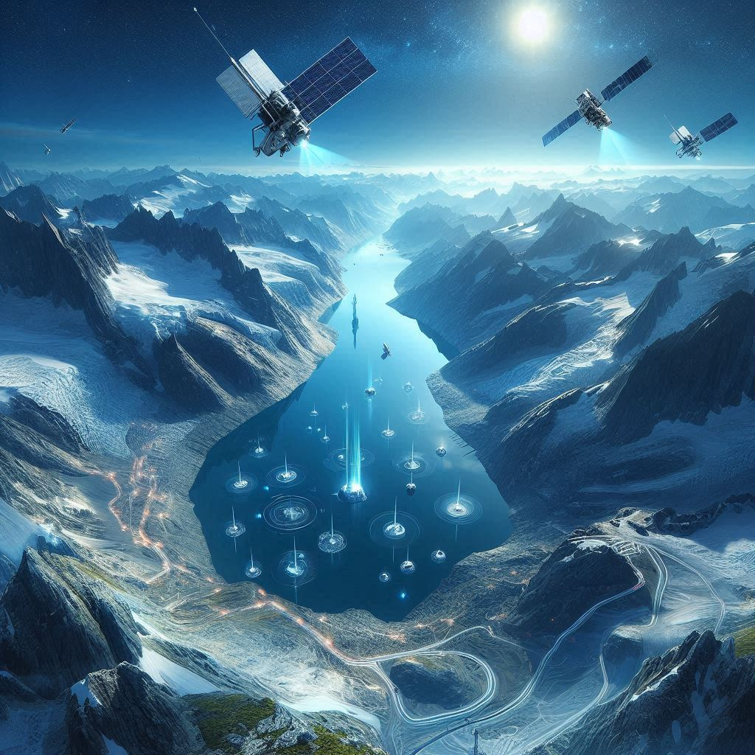
GLACIAL LAKE OUTBURST FLOOD
Project category:
Open Innovative
Institute name:
Shiv Nadar University
Team leader :
Pradita G
Team
Name:
Glacial Gliders

Slide 2
Problem description :
Main aim :
Our project focuses on developing an early warning system for Glacial Lake Outburst Floods (GLOFs), a critical natural hazard in high mountain regions.
Significance :
the unavailability of proper technology to track the occurring of the glacial lake outburst before hand is what causes loss of life, many other factors which change drastically before the major flood, detecting them using a proper methodology can help reduce after effect
What can be done: ?
Using a network of advanced sensors placed around vulnerable glacial lakes, we aim to continuously monitor key factors like water levels, pressure, and temperature. These real-time data inputs will be processed through a cloud-based platform, integrated with predictive algorithms to detect potential threats. When abnormal conditions are detected, immediate alerts will be sent via multiple communication channels, including SMS, mobile apps, and public announcement systems, ensuring that local communities and authorities receive timely warnings.
Cons of the system:
This system will provide crucial lead time for evacuation and disaster mitigation, reducing loss of life and property. By leveraging sensor technology, machine learning, and real-time data analytics, our solution offers a robust and scalable approach to safeguarding communities in GLOF-prone regions.​
​
​
.

Slide 3

STRUCTURED SOLUTIONS

Slide 4
FLOW :
Sensors are deployed at the area of monitoring
Components
website
sensors
The data is extracted from the satellite images
Satellite data
the data collected is processed
Used to train the algorithm
Data processing
Warning system
Limits or end points set to calculate the abnormal changes
Cloud
Warning sent to the local people and continuously updating the current state of the glacier through website

Slide 5
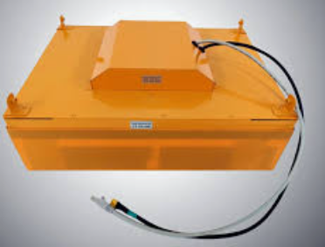
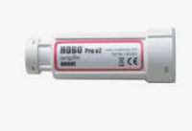
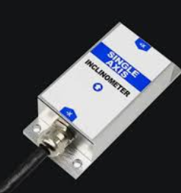
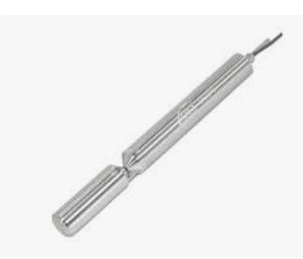
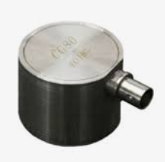
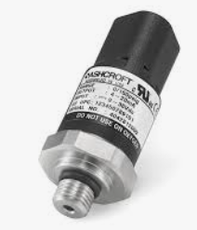
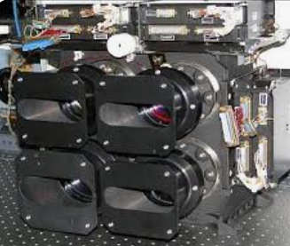
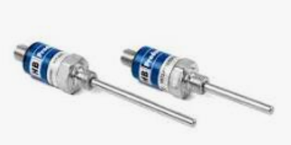
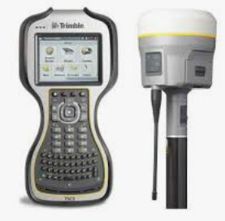
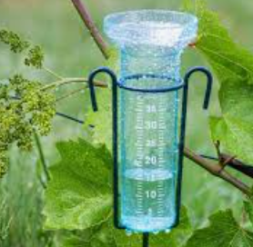
S
E
N
S
O
R
S
GROUND PENETRATING RADAR – Changes in ice thickness ​
INCLINOMETERS
detect any tilting or deformation of the structures.​
HOBO U23-004 – Glacial temperature
ACOUSTIC EMISSION SENSORS- High frequency sounds produced by the fracturing is detected
OTT HYDROMET RLS – Non contact water level measurement, sudden raises detected​
PRESSURE TRANSDUCERS – pressure exerted by the water on the dam walls
monitoring changes in the surface area of the glacier lake​
TRIMBLE R10 GNSS RECIEVER – GPS measurement to track shifts in land to indicate slope instability​
PT100/1000 RTD – Water temperature detection with high accuracy ​
RAIN GAUGE – Measures precipitation levels ​

Slide 6

1 .Data collection and storage
Consists of
IOT integration - usage of AWS IOT sensors
Satellite imagery – integrate the satellite data from the Awifs for storage and analysis purpose
Data lake : create a centralized data lake using the AWS glue to store and process the data
C
L
O
U
D
2. Data processing and analysis :
Machine learning : usage of the AWS Sage maker to train the model that can predict the GLOF using the historical data as well
Using technologies like the EMR used to perform the data analytics
Image processing : we can use services like the EC2 instances to identify hazards like dam failures in advance
3. Real time monitoring and alerts :
Kinesis Data Streams: using this to stream real-time data from sensors and satellite imagery for immediate processing​
Lambda Functions: Create serverless Lambda functions to trigger actions based on incoming data, such as sending alerts or activating downstream warning systems.​
SNS (Simple Notification Service):sending simple notifications

Slide 7
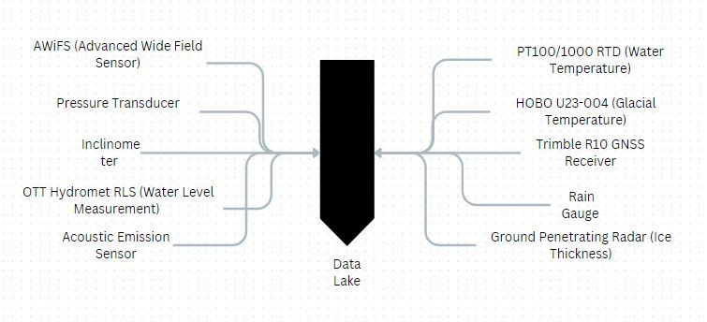
INTEGRATION :
This data from the sensors are taken and then merged into a data lake which can again be used for monitoring the glaciers
These sensor will provide the monitored data

Slide 8

DATA LAKE
Data preprocessing for Logistic regression(scaling+ Flattening + Binary Target)
Data preprocessing for LSTM
(Scaling + Sequence creation)
Logistic regression
Model training
LSTM Model
Training
Real time data Simulation
(appending new data)
Real time prediction with LSTM
Real time prediction with logistic regression (Probability calculation
Warning generation (based on the probability
Visualization (Actual vs predicted data + Warning)

Slide 9
Machine learning
Data Loading: It loads real data from a CSV file (from a data lake) and extracts the relevant time series values.
​​Preprocessing: Scales the data and prepares it into small sequences to be used for training and prediction.
​​LSTM Model Building: A simple LSTM (Long Short-Term Memory) model is built to predict future values based on past data.​​
Model Training: The LSTM model is trained on the preprocessed sequences.
​Real-Time Prediction: It simulates new data coming in and continuously predicts future values based on recent trends.​​
Visualization: The actual and predicted values are plotted, showing real-time forecasting over time.​​

Slide 10


SCALABILITY
FLEXIBILITY:
Flexible Architecture:​
Modular design enables easy integration of new sensors, data sources, and machine learning models.
​
Robust Infrastructure:​
Cloud-based infrastructure ensures reliability with auto-scaling for growing data streams.​
Data Handling:​
Efficient real-time management of sensor data, scalable across multiple locations.​
Future-Proofing:​
Designed to integrate future ML algorithms and sensor technologies.​
Enhanced User Experience:​
Continuous forecasting, accurate warnings, and user-friendly visualization, even at scale.​
Machine learning integration for real-time flood risk assessment.​
Multi-source data fusion for better predictive accuracy.​
Time-stamped warnings to support traceability and post-event analysis.​
Web-based interface for user-friendly visualizations and real-time monitoring.
​
Adaptable system for different regions and environments.​
Potential for satellite data fusion to enhance spatial coverage.​
Forecasting capabilities to issue early and proactive warnings.​
​

Slide 11
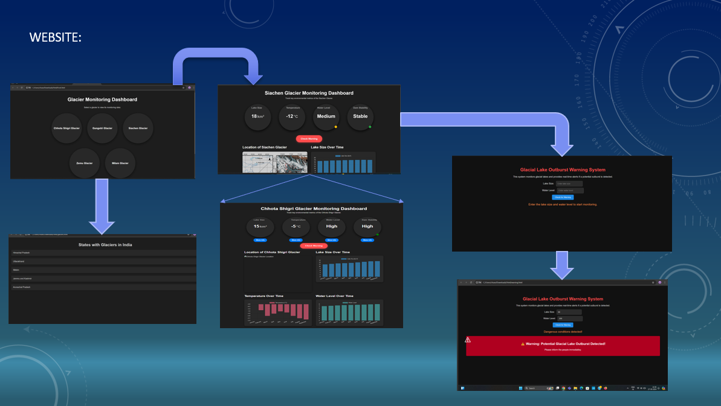

Slide 12
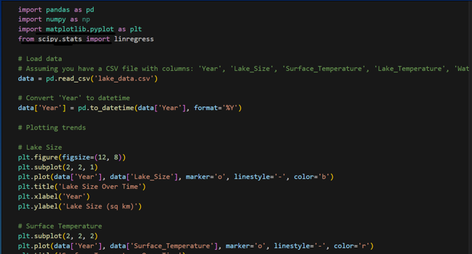
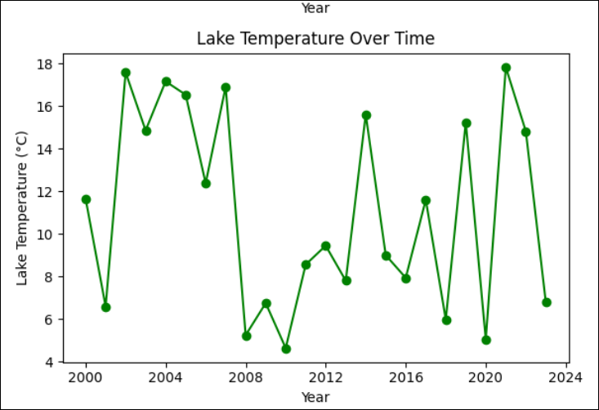
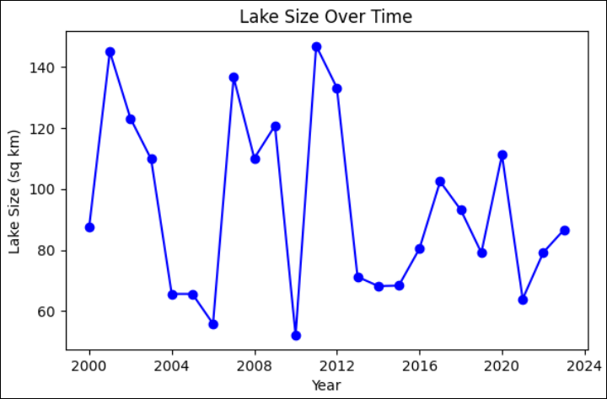
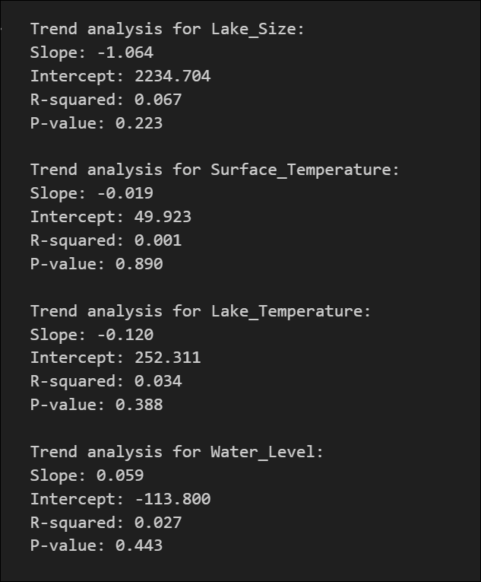
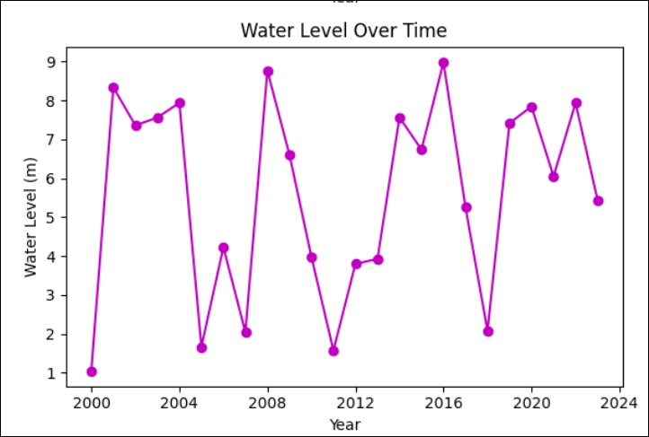
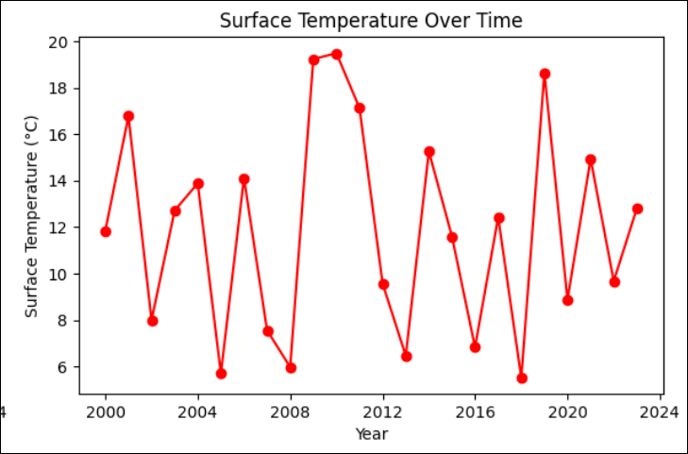
DATA PROCESSING USING THE EXTRACTED VALUES

Slide 13
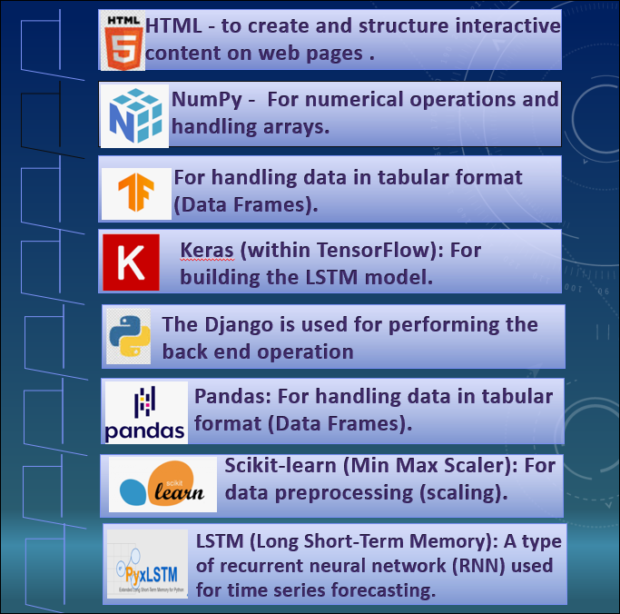
TECH
STACK

Slide 14

Thank You!

